Slide 1
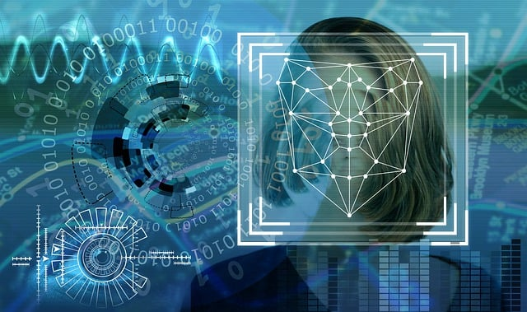
MOUSE CURSOR CONTROL USING FACIAL MOVEMENTS IN REAL- TIME APPLICATIONS
Presented by:
Bhavadharani Vembi.K

Slide 2
AGENDA
Abstract
Introduction
Problem Statement
Proposed Objective
Implementation
Presentation Ti

Slide 3
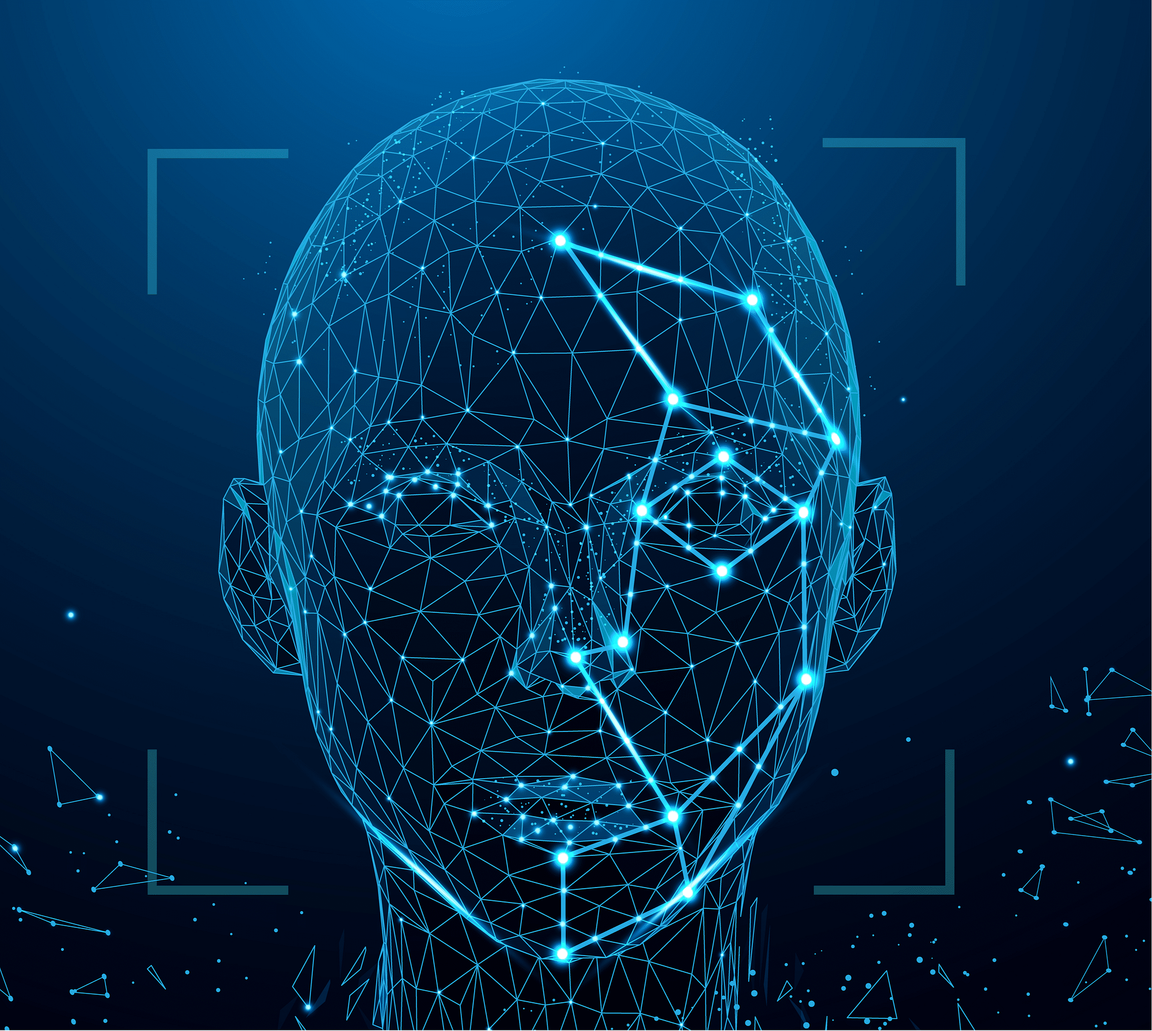
Abstract
People with physical disabilities play a significant role in our society. The idea of eye controls is particularly advantageous for the development of natural input as well as for people with disabilities and other impairments.
The goal of this project is to introduce new technology to persons with disabilities. This research presents an algorithm that is designed with impaired persons in mind.
We used a toolkit called Dlib, which not only performs rapid face detection but also helps us to predict facial landmarks.
This algorithm handles user-machine interaction allows people with physical disabilities to move the computer cursor with the use of facial expressions to the left, right, up, and down directions. Through winks and blinks, the algorithm also enables the user to open and close folders, files, and apps. It provides disabled people with the chance to work.

Slide 4


Personal computer systems now play an important role in our daily lives, as they are used for work, education, and enjoyment. Computers are made to be readily available for regular people. However, using a computer can be extremely difficult for people with physical limitations like cerebral palsy or amyotrophic lateral sclerosis. In order to enhance the user's contact with the computer system, numerous research studies on human computer interface (HCI) have been conducted. Touch-sensitive screens, speech recognition technology, and many more technologies are among these interfaces. Most of these only apply to normal people. The concept of eye controls is quite helpful for the growth of natural input.
Introduction

Slide 5
In order to control a non-intrusive human-computer interface, the proposed work involves face detection, face tracking, eye-blink detection, mouth gestures, and interpretation of a sequence of blinks in real time. Using the human face and eye movements to engage with the computer instead of the conventional mouse. It is intended to make computer use efficient and simple for those who are physically disabled and lack hands. We use a camera in this project to track the position of the eyes as well as their motion, which is used to determine where the eyes are looking. This allows us to track the motions of our eyes and utilize them as signals to control and enable computer interaction. Using eye tracking, this is a straightforward solution for persons with physical disabilities. The only thing we require is a laptop or PC that has a webcam built in.
Introduction

Slide 6
Problem Statement
The problem of using facial recognition for mouse cursor control is its potential lack of precision and reliability.
Facial recognition technology may struggle with accuracy, especially in varying lighting conditions, different facial expressions, or if the user wears glasses or changes appearance (like growing a beard or changing hairstyles).
This can lead to unintended cursor movements or difficulty in performing precise tasks, which could be frustrating for users and hinder productivity.
Additionally, facial recognition systems may raise privacy concerns due to the collection and processing of biometric data.

Slide 7
Advantage Of Proposed Objective
Our system uses face detection and facial features to track the movement of the mouse cursor in real time without being intrusive. By removing the usage of external gear that seriously injured eyes, it out-performs the current system.
The first step was to use a face detection algorithm to locate the face on an image frame captured by an ordinary webcam. Once a face has been found, facial landmarks can be predicted with accuracy. With the use of these anticipated facial landmarks, we may create the necessary features to enhance our ability to recognise specific behaviours and carry out associated actions

Slide 8
Novelty
Instantaneous Responses
Dynamic Adaptation
Interactive Feedback
Live Interaction
Adaptive Accessibility
Facial recognition algorithms analyze facial movements in real-time, translating them into cursor movements with minimal delay. This immediate response creates a sense of fluidity and direct interaction for users, enhancing the overall user experience.
Real-time facial tracking enables the system to dynamically adapt to changes in facial expressions and movements, allowing for precise and responsive cursor control. Users can seamlessly navigate interfaces, interact with content, and perform actions without noticeable lag or interruption.
Real-time feedback mechanisms, such as visual indicators or auditory cues, provide users with immediate confirmation of their facial gestures' effects on cursor movement. This feedback loop enhances user engagement and fosters a sense of control and empowerment.
In live applications such as video conferencing or virtual events, real-time mouse cursor control using facial movements enables participants to actively engage with shared content or collaborate on documents with natural gestures. This live interaction fosters more dynamic and engaging communication experiences.
Real-time facial recognition technology can dynamically adjust cursor control parameters based on individual users' facial characteristics and movements in real-time. This adaptability ensures accessibility for diverse user populations and accommodates variations in facial expressions or mobility.

Slide 9
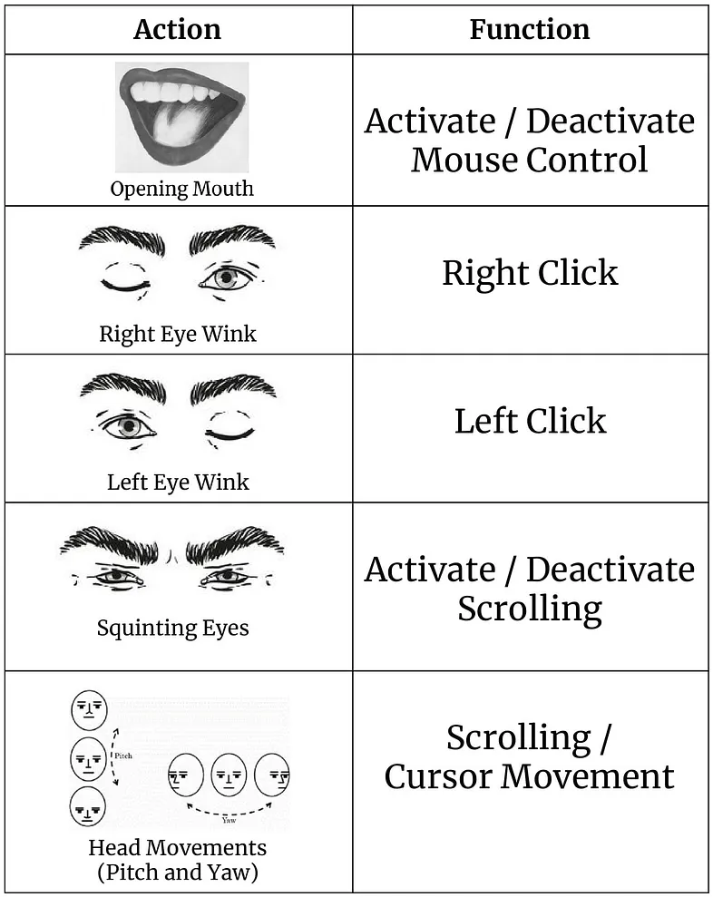
USAGE

Slide 10
Implementation
Implementing mouse cursor control using facial movements in python involves several steps:
Facial Detection: Use a facial detection algorithm to detect and track the user's face in real-time. Popular libraries like OpenCV or Dlib can be used for this purpose.
Facial Landmark Detection: Once the face is detected, use a facial landmark detection algorithm to identify key points on the face, such as the eyes, nose, and mouth. Libraries like Dlib or OpenCV's Deep Learning module can be used for this step.
Calculating Facial Movements: Analyze the movement of facial landmarks, particularly those around the eyes and eyebrows, to determine the direction and extent of facial movements.
Mapping to Mouse Cursor Movements: Map the detected facial movements to mouse cursor movements. For example, if the user raises their eyebrows, move the cursor upwards; if they squint, move the cursor downwards, and so on.
Cursor Control Algorithm: Implement a cursor control algorithm to ensure smooth and intuitive control of the mouse cursor based on facial movements. This may involve filtering noisy signals, setting appropriate sensitivity thresholds, and adjusting cursor speed.
Integration with Operating System: Use libraries or system APIs to control the mouse cursor programmatically. This typically involves sending mouse movement and click commands to the operating system.

Slide 11
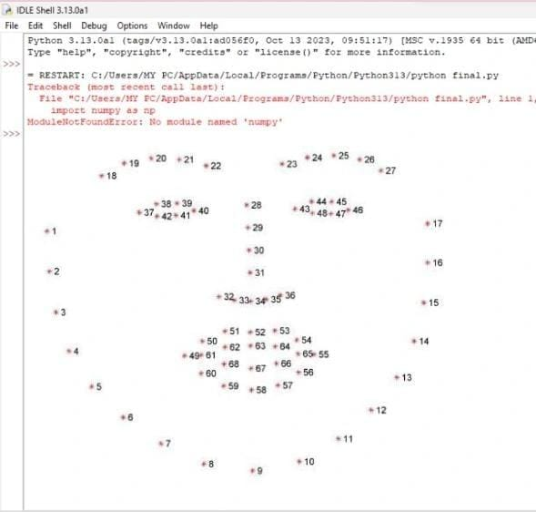
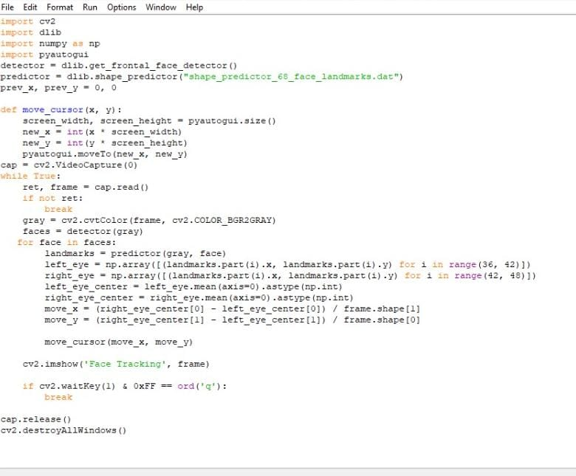

Slide 12
Conclusion
A system that makes it possible for a person with a disability to engage with a computer has been successfully designed and tested. The technique can be improved even more and applied in several other applications. The system can be modified to make it easier for people with disabilities to operate home appliances like TVs, lights, doors, etc.
A smart system, which is adapted, efficient, and robust to help to detect the emotions of the disabled people who could not make physical movements easily. These people tend to be seated in wheelchair and require full-time assistance in most of their physical movements.
The recognition and analysis of eye movements have potential applications in virtual reality and gaming.

Slide 13
Reference
[1] "Controlling a wheel chair indoors using thought" B. Rebsamen, C. L. Teo, Q. Zeng, M. Ang. Jr. IEEE Intelligent Systems, 2007, pp. 18-24.
[2] C. A. Chin "Enhanced Hybrid Electromyogram / Eye gaze tracking cursor control system for hands-free computer interaction”, Proceedings of the 28th IEEE EMBS Annual International Conference, New York City, USA, Aug 30-Sept 3, 2006, pp. 2296-2299.
[3] J. Kierkels, J. Riani, J. Bergmans, “Using an Eye tracker for Accurate Eye Movement Artifact Correction”, IEEE Transactions on Biomedical Engineering, vol. 54, no. 7, July 2007, pp. 1257-1267.
[4] A. E. Kaufman, A. Bandyopadhyay, B. D. Shaviv, "An Eye Tracking Computer User Interface", Research Frontier in Virtual Reality Workshop Proceedings, IEEE Computer Society Press, October 1993, pp. 78-84..

Slide 14
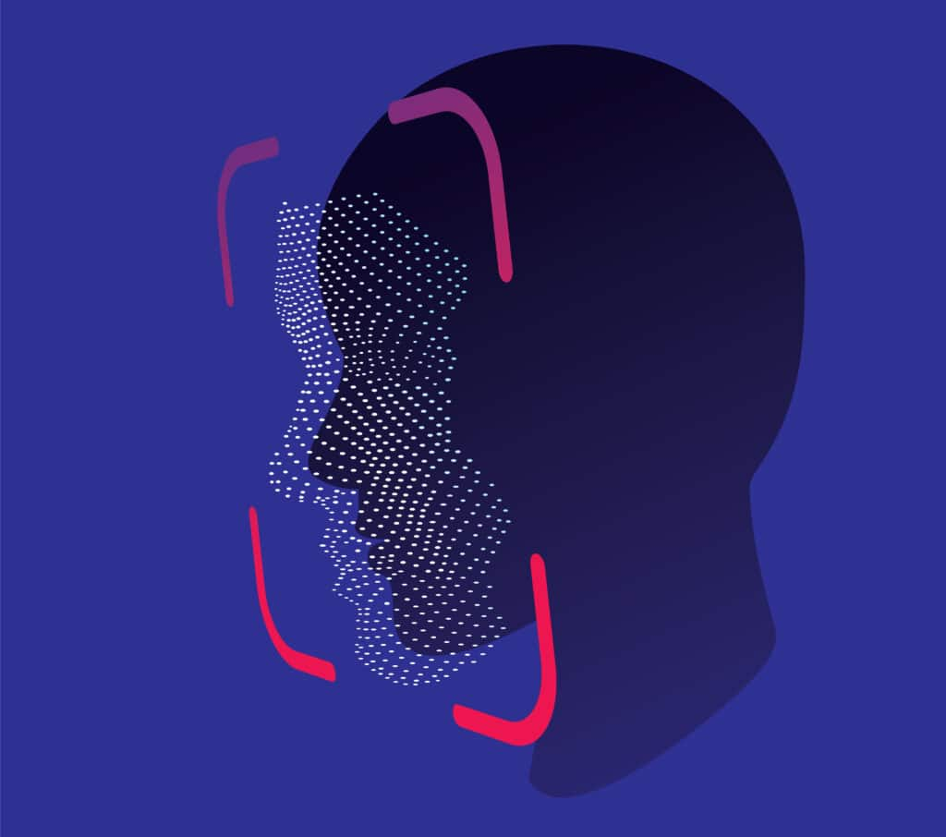
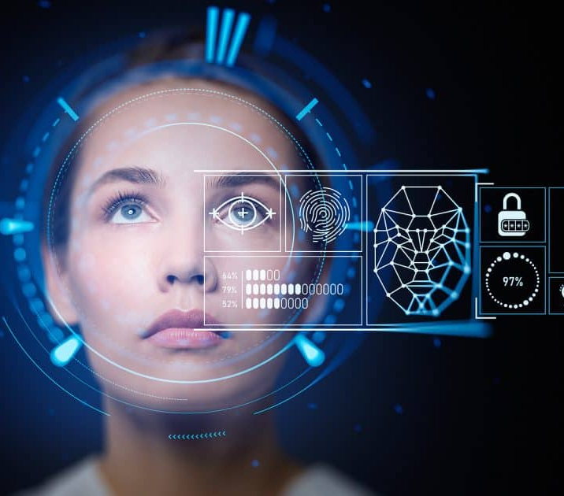
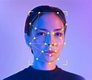
Thank you

